Slide 1
Thunderbots@Home
Compiling, Testing, Software Setup by Devon Ash

Slide 2
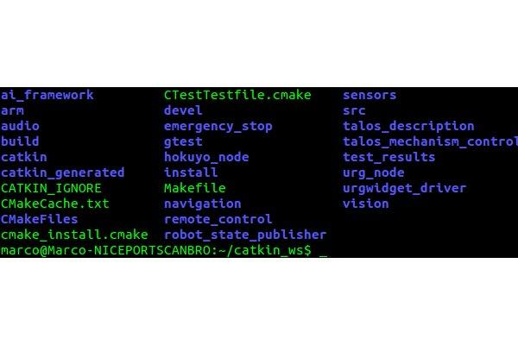
~/catkin_ws:
Top level: catkin_ws This is where you catkin_make.

Slide 3
Inside of ~/catkin_ws:
~/catkin_ws/src:This is where your catkin packages are written. This is where you catkin_create_pkg This is where you put the vision, sensors, scripts, and navigation (etc..) catkin packages
~/catkin_ws/devel:This is where all your executables go when you compile This is where all your .lib.so files go
~/catkin_ws/install:This is where the install files go Install files set up the workspace for the package, setting server parameters, shell parameters, global variables, etc

Slide 4
Inside of ~/catkin_ws:
~/catkin_ws/src:This is where your catkin packages are written. This is where you catkin_create_pkg This is where you put the vision, sensors, scripts, and navigation (etc..) catkin packages
~/catkin_ws/devel:This is where all your executables go when you compile This is where all your .lib.so files go
~/catkin_ws/install:This is where the install files go Install files set up the workspace for the package, setting server parameters, shell parameters, global variables, etc

Slide 5
Inside of ~/catkin_ws:
~/catkin_ws/src:This is where your catkin packages are written. This is where you catkin_create_pkg This is where you put the vision, sensors, scripts, and navigation (etc..) catkin packages
~/catkin_ws/devel:This is where all your executables go when you compile This is where all your .lib.so files go
~/catkin_ws/install:This is where the install files go Install files set up the workspace for the package, setting server parameters, shell parameters, global variables, etc

Slide 6
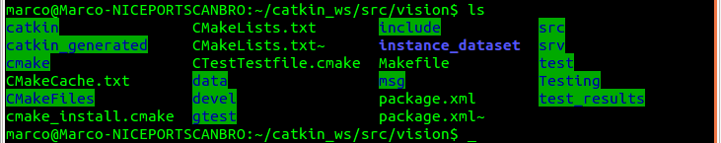

A package inside ~/catkin_ws/src:
The vision package, for example:
And the navigation package:

Slide 7
Important Elements in a Package:
Lets use the vision package as a turkey (it has stuffing)
From scratch, I’ll recreate the package. We’ll call it vision-example.

Slide 8
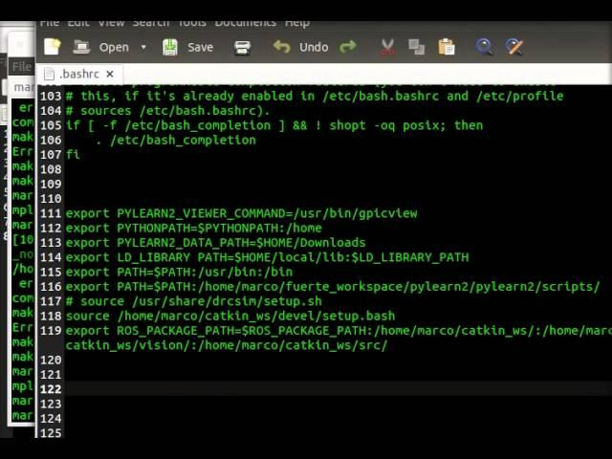
A video from creation to compilation

Slide 9
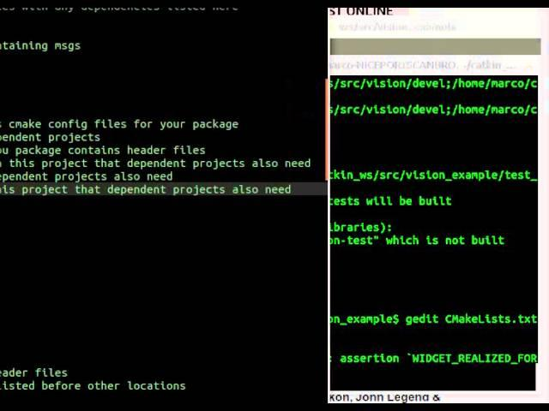
A video for compiling test cases
Gtest Docs: http://code.google.com/p/googletest/

